Slide 1
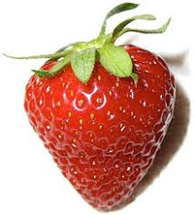


Daily Review
The physical properties of an object describe its appearance. Physical properties could include its colour, shape, size or pattern.
On your whiteboard, give two physical properties of each object below:

Slide 2
Properties of Rocks Year 8 Science

Slide 3
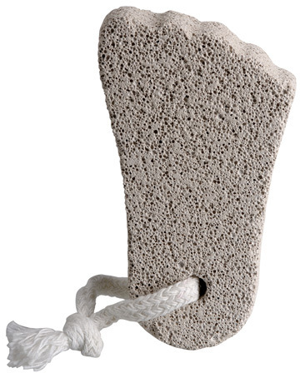
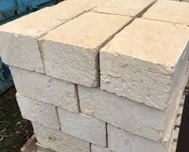
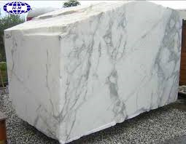
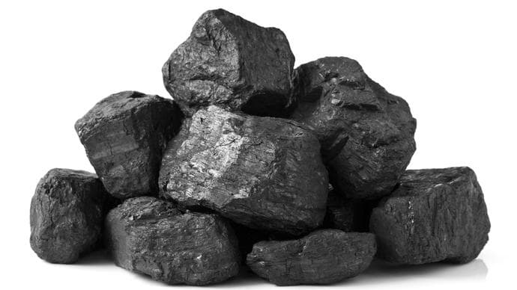
Learning Objective
CFU
What are we going to describe?
Describe the physical properties of rocks.
Activate Prior Knowledge
Different types of rocks are used for different purposes.
Think, Pair, Share: What are each of these common rocks used for in our everyday lives?
Pumice
Limestone
Marble
Coal

Slide 4
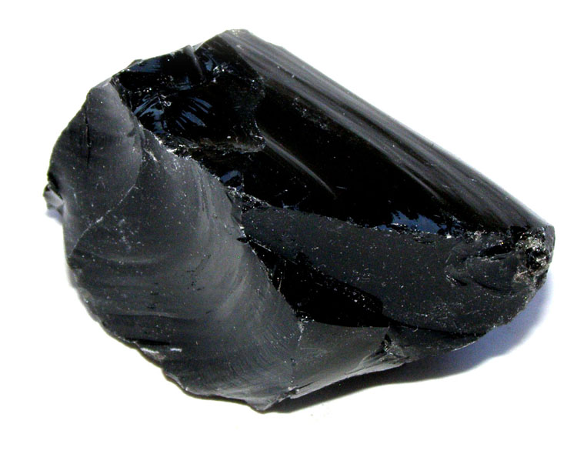
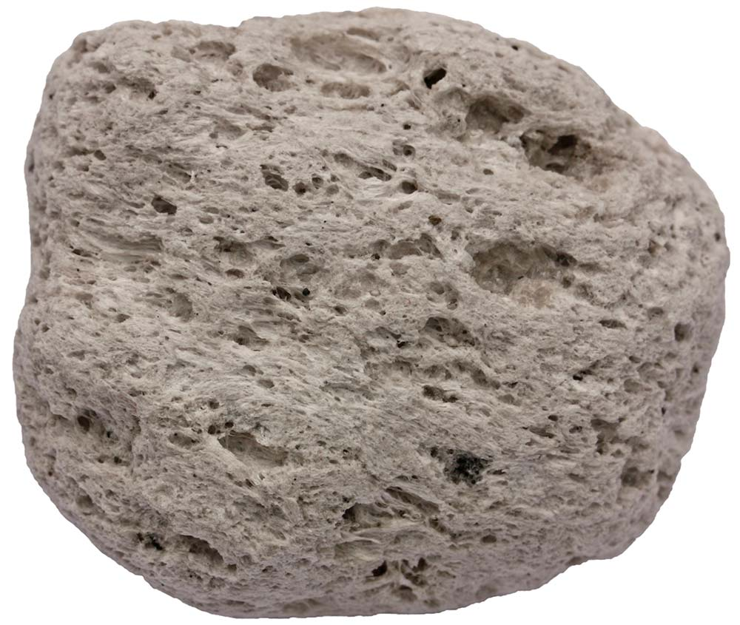
Concept Development
CFU 1
What is a property?
Properties of Rocks
Different types of rocks have different properties that geologists use to identify them.
Some common properties geologists use are:
Colour
Layers
Grains or crystals
Air holes
CFU 2
How are geologists able to identify different rocks?
CFU 3
Which property could be used to identify the difference between obsidian and pumice? Explain your choice.
Obsidian
Vocabulary
property characteristic, feature or quality geologist scientist who studies rocks
Pumice

Slide 5
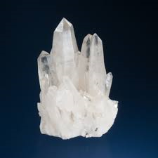
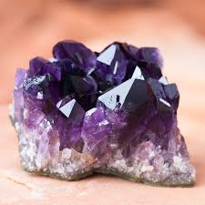
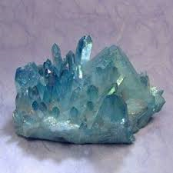
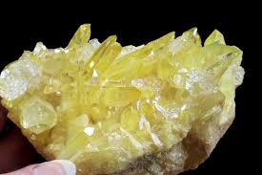
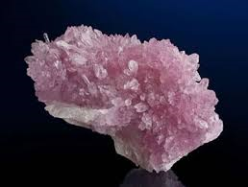
Concept Development
CFU 1
What gives rocks their colours?
Colour
The colour of a rock is determined by the chemicals in the rock.
Pure quartz is white in colour. Small amounts of other chemicals can change the colour of the quartz.
CFU 2
What physical property has changed in the quartz rocks pictured?
1
3
Vocabulary
property characteristic, feature or quality geologist scientist who studies rocks
2
4

Slide 6
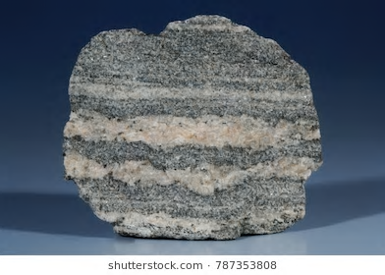
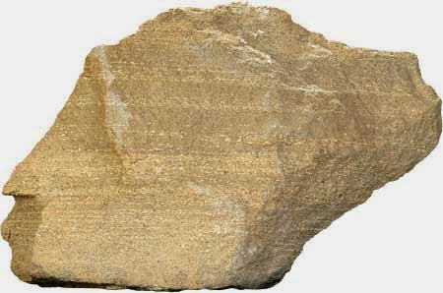
Concept Development
CFU 1
How many layers can you see in the gneiss?
Layers
Some rocks have layers of different colours (e.g. gneiss).
Some rocks have layers of different sized grains (e.g. sandstone).
CFU 2
What is different about the layers in the sandstone?
Vocabulary
property characteristic, feature or quality geologist scientist who studies rocks
Gneiss
Sandstone

Slide 7
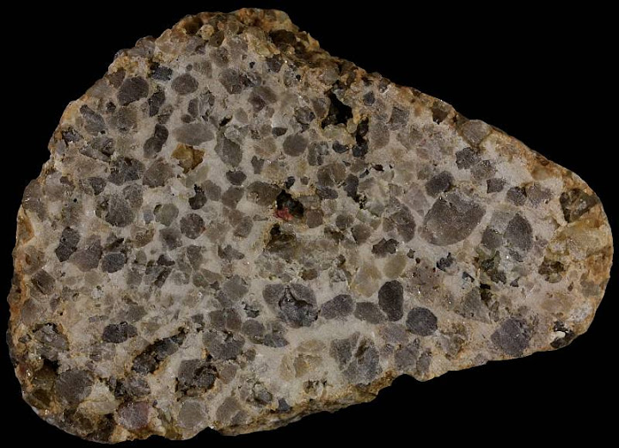
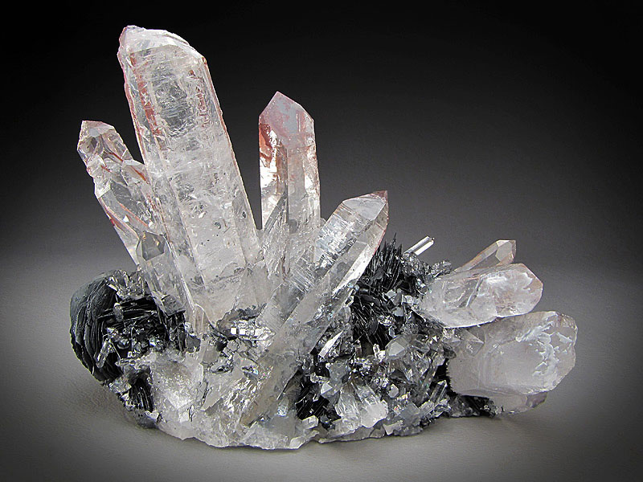
Concept Development
CFU 1
Is the conglomerate made of crystals or grains? Explain your choice.
Crystals or Grains
Rocks can be made from crystals or grains.
Grains have symmetrical rounded edges.
Crystals have sharp irregular edges and smooth sides.
Crystals may be so small they are not easily visible.
CFU 2
Is quartz made of crystals or grains? Explain your choice.
Vocabulary
property characteristic, feature or quality geologist scientist who studies rocks
Conglomerate
Quartz

Slide 8
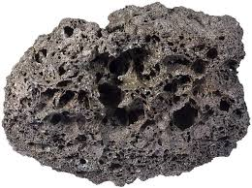
Concept Development
CFU 1
The three rocks shown are all made in the same way. Which one has: Large holes? Small holes? No holes?
Air Holes
Some rocks contain holes from gases in the rocks when they were formed.
The holes can be large (the size of a pea), small (the size of a match head) or not present at all.
CFU 2
Which of the three rock samples had the largest gas bubbles? Explain your choice.
Vocabulary
property characteristic, feature or quality geologist scientist who studies rocks
Pumice
Obsidian
Scoria

Slide 9
Skill Development/Guided Practice
CFU 1
What is its colour?
Steps for describing rocks
Step 1: Describe its colour
Step 2: Describe any layers
Step 3: Identify any crystals or grains
Step 4: Identify if any holes are present
Conglomerate is a variety of colours, but mostly grey and pale brown. It does not have layers. It is made of grains. It does not have holes.
CFU 2
Does it have layers?
CFU 3
Are there crystals or grains?
Conglomerate
CFU 4
Are there holes present?
Vocabulary
property characteristic, feature or quality geologist scientist who studies rocks

Slide 10
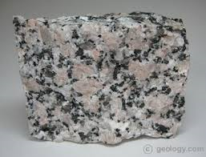
Skill Development/Guided Practice
CFU 1
What is its colour?
Steps for describing rocks
Step 1: Describe its colour
Step 2: Describe any layers
Step 3: Identify any crystals or grains
Step 4: Identify if any holes are present
Granite is white, black and pink. It does not have layers. It is made of crystals. It does not have holes.
CFU 2
Does it have layers?
CFU 3
Are there crystals or grains?
Granite
CFU 4
Are there holes present?
Vocabulary
property characteristic, feature or quality geologist scientist who studies rocks

Slide 11
Skill Development/Guided Practice
CFU 1
What is its colour?
Steps for describing rocks
Step 1: Describe its colour
Step 2: Describe any layers
Step 3: Identify any crystals or grains
Step 4: Identify if any holes are present
CFU 2
Does it have layers?
CFU 3
Are there crystals or grains?
Pumice
CFU 4
Are there holes present?
Vocabulary
property characteristic, feature or quality geologist scientist who studies rocks

Slide 12
Skill Development/Guided Practice
CFU 1
What is its colour?
Steps for describing rocks
Step 1: Describe its colour
Step 2: Describe any layers
Step 3: Identify any crystals or grains
Step 4: Identify if any holes are present
CFU 2
Does it have layers?
CFU 3
Are there crystals or grains?
CFU 4
Are there holes present?
Sandstone
Vocabulary
property characteristic, feature or quality geologist scientist who studies rocks

Slide 13
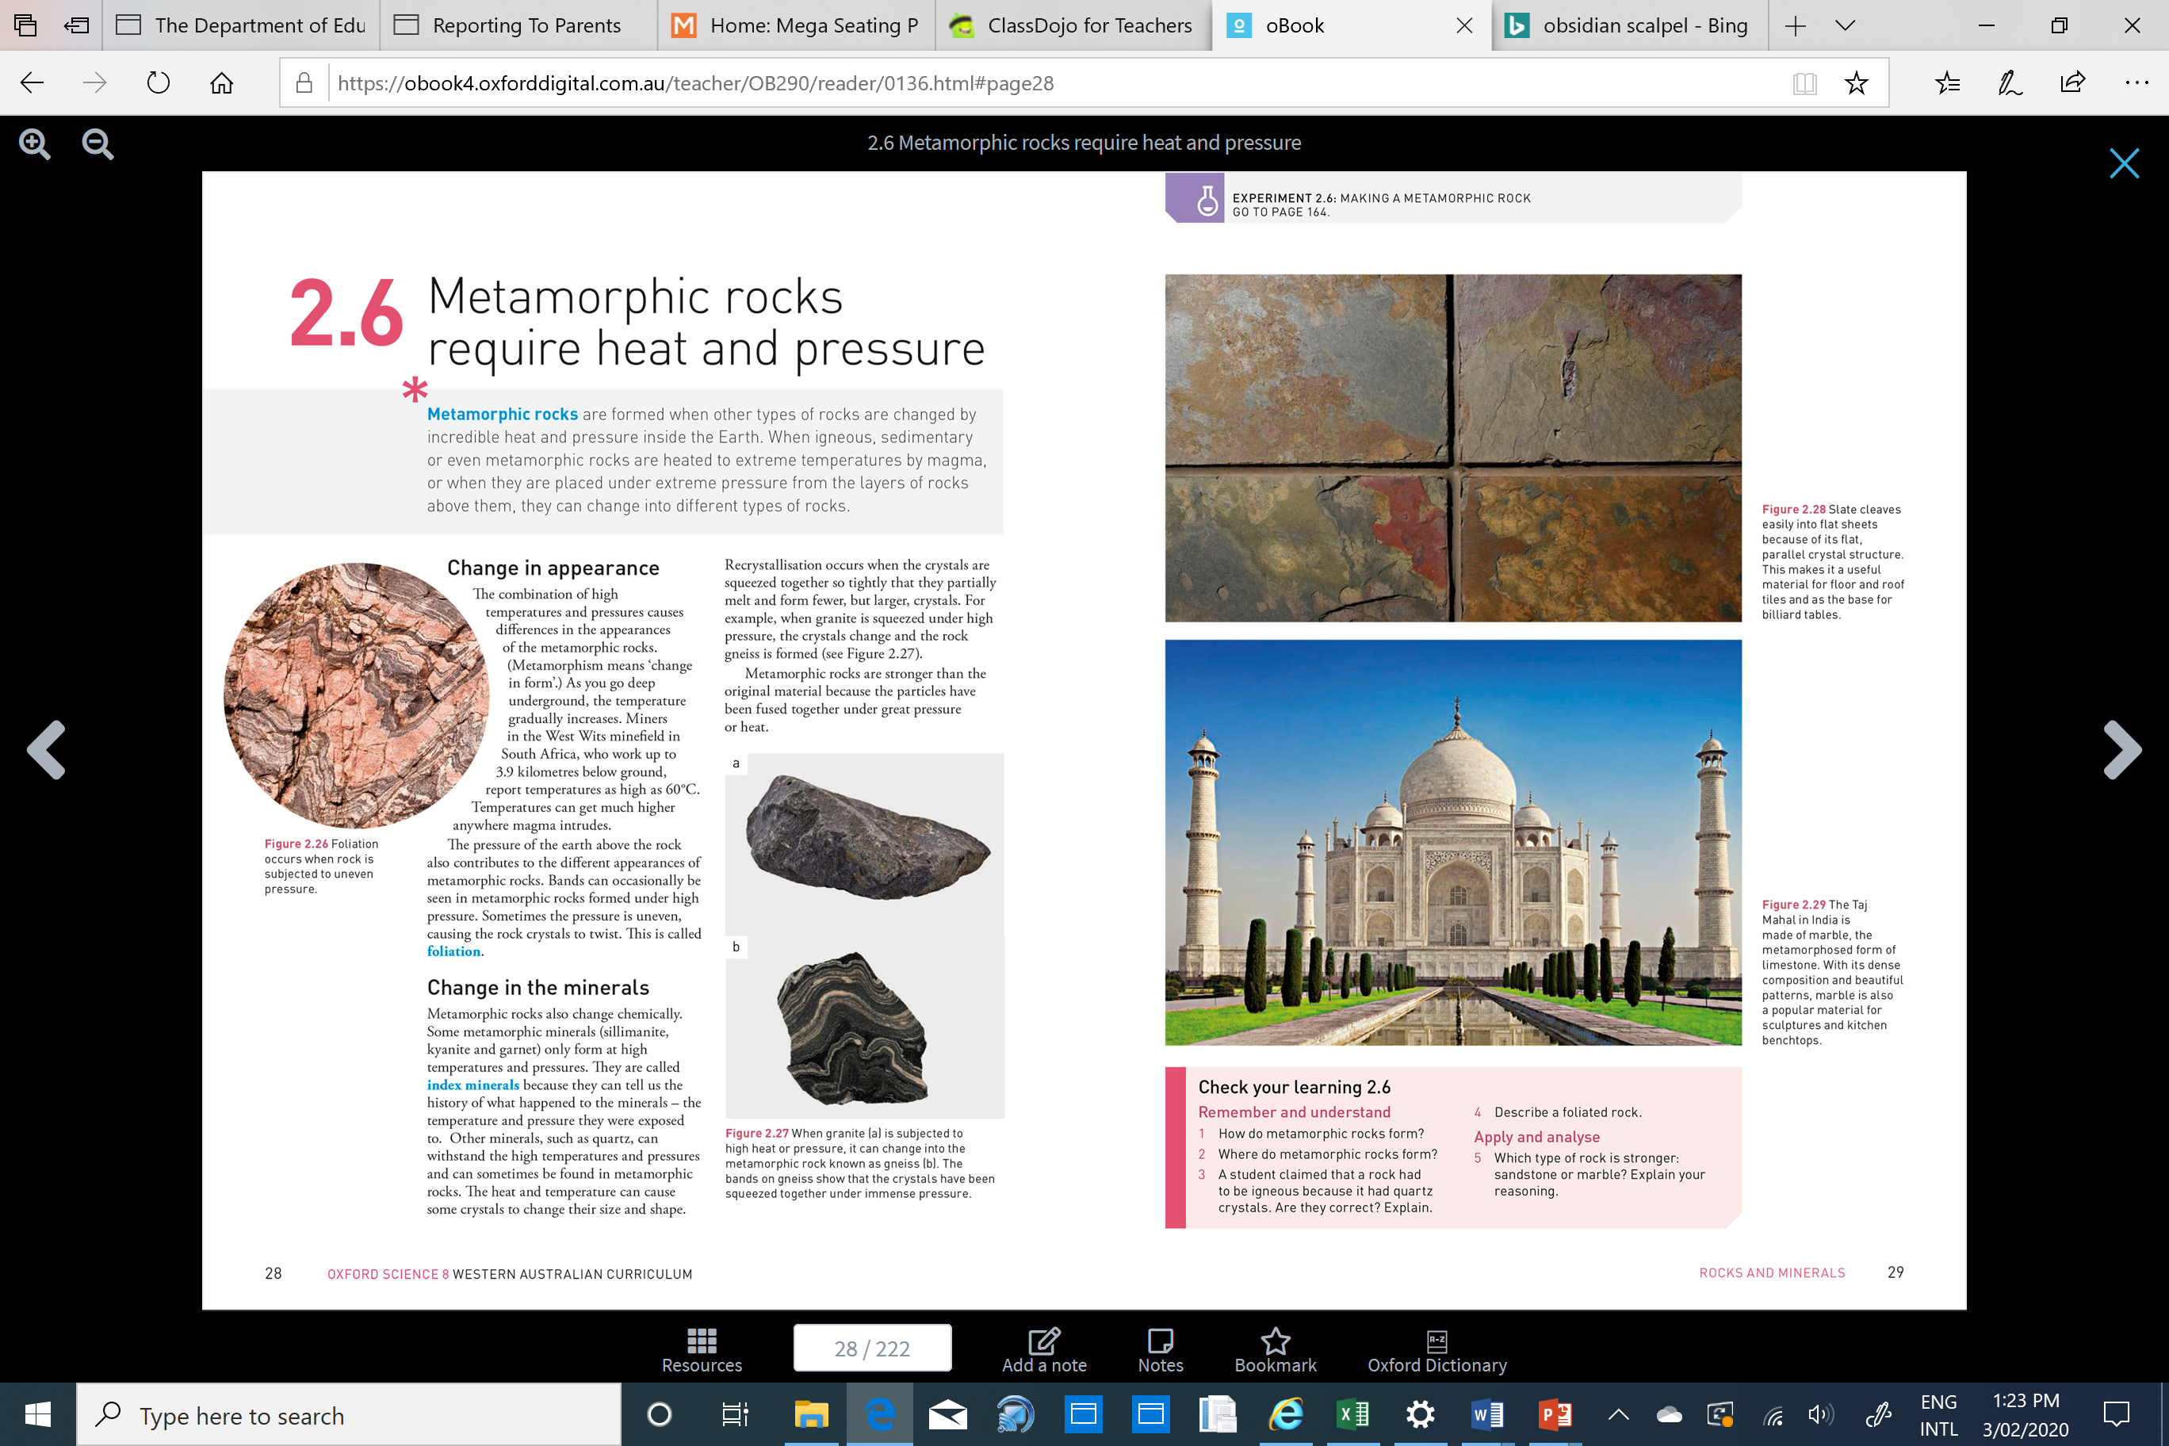
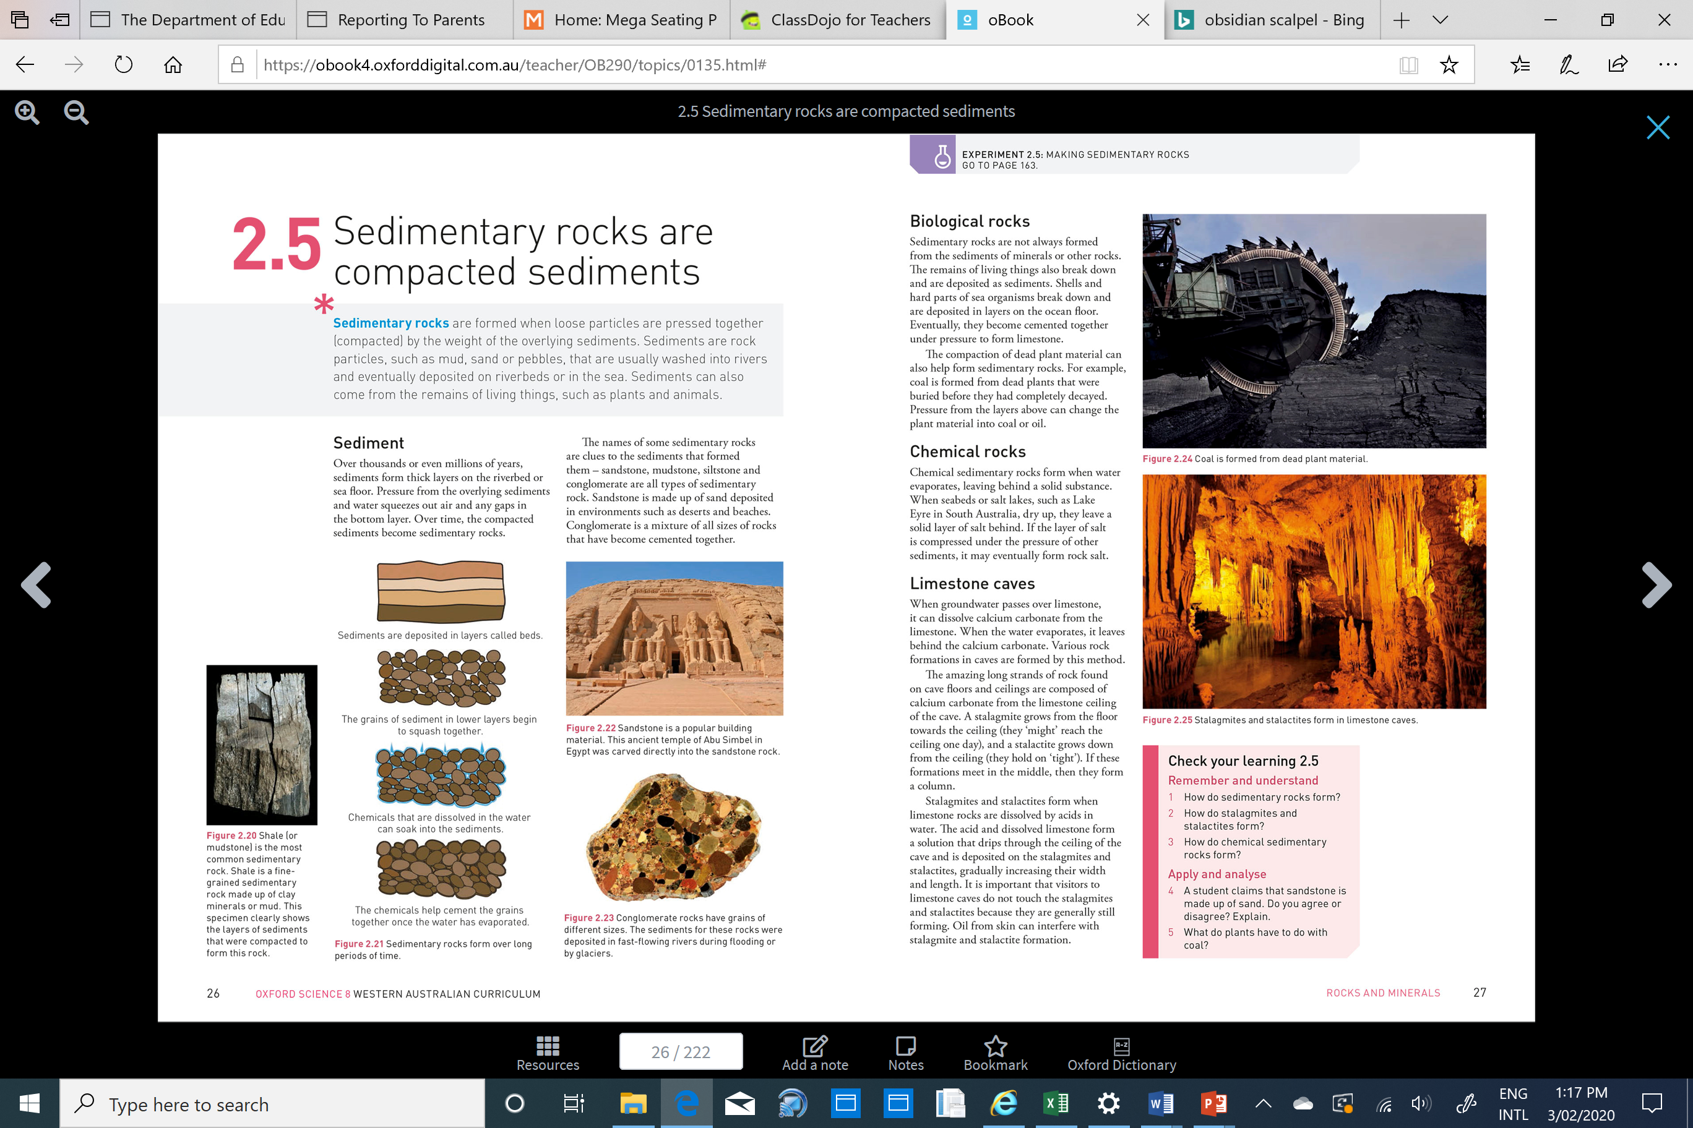
Relevance
Being able to describe the properties of rocks will help you to identify rocks and understand how they were formed.
The properties of a rock will affect what they are useful for.
Notes:
Slate cleaves easily into flat sheets, this makes it useful for floor and roof tiles
The Taj Mahal is made of marble as it is strong and has beautiful patterns
Sandstone is soft and easily carved into.

Slide 14
Skill Closure
Reminder
Steps for describing the properties of rocks Step 1: Describe its colour Step 2: Describe any layers Step 3: Identify any crystals or grains Step 4: Identify if any holes are present
Explain how crystals are different to grains.
Skill Closure
Describe the properties of quartz.

Slide 15
Independent Practice
Draw a table with 2 columns and 17 rows in your book or on your device. In the first column, put the heading “Rock Name” and in the second column, put the heading “Properties”
Look at the pictures of the rocks on page 19 of the text book and describe the properties of each rock. (You may not be able to describe all four properties for each rock.)
In your books or on your device answer the questions on page 19 of the textbook.

Slide 16
Independent Practice - ANSWERS
Step 1
What is its colour?
Rock Name | Properties
Basalt | Dark green / black, no layers, crystals, no air holes
Coal | Black , no layers, crystals, no air holes
Conglomerate | Mixed colours (orange, yellow brown), no layers, grains, no air holes
Gneiss | Grey / brown, it has layers, crystals, no air holes
Granite | Red, no layers, crystals, no air holes
Limestone | Cream, no layers, grains, no air holes
Marble | Pinky / orange, no layers, crystals, no air holes
Obsidian | Shiny black, no layers, crystal, no air holes
Pumice | Grey, no layers, crystals, has air holes
Quartzite | Light grey, usually layered (not in picture), crystals, no air holes
Rhyolite | Pinky / white, no layers, crystals, no air holes
Sandstone | Yellow / orange, layers, grains, no air holes
Schist | Dark grey and brown, usually layered (not in picture), crystals, no air holes
Scoria | Dark grey, no layers, crystals, has air holes
Shale | Black, layers, SUPER fine grains, no air holes
Slate | Black, layers, SUPER fine grains, no air holes
Step 2
Does it have layers?
Step 3
Are there crystals or grains?
Step 4
Are there holes present?

